Slide 1
Information Processing Techniques
Week 01
NAZ MEMON

Slide 2
Let’s Introduce Ourselves
Name: Naz Memon
Qualifications: ME (IT) from MUET (2022), BE (CSE) from MUET (2016)
Courses Taught: Operating Systems, OS Lab, Discrete Structures, Data Science and Analytics, Database Management Systems
Welcome back to the university Wishing you best of luck for the Semester

Slide 3
Consultation Hours
Faculty Offices basement 2, Room # 22
Tuesday: 9 am to 1 am
Do email me before visiting!
Email: naz.memon@nu.edu.pk

Slide 4
Pre- Requisites
The course assumes that you have prior knowledge on the following:
Software Engineering
Programming Basics using Java

Slide 5
Course Outline
- You may find the course outline on Google Classroom.
- Assignments:
Likely to be 2-3 assignments.
- Classroom Performance\HomeTasks
Mandatory and Observed closely
- Quizzes:
None!
- Project
Main objective for securing marks and course understanding

Slide 6
Grading Scheme
Assignments 10 %
Project 10 %
Midterms (2) 30 %
Final 50 %

Slide 7
Course Teaching Policies
Mandatory attendance and punctuality; 15-minute late mark as absent.
No late submissions accepted.
Plagiarism results in 0 for the question.
No quiz or assignment retakes.
Kindly bring your laptops in theory class as well. (Necessary)
Respectful behavior toward tutor and peers required.
Active participation impacts final grade.
Cell phones and devices off during class.

Slide 8
Reference Books
Java How to Program, Early Objects, Global Edition Paperback by Harvey Deitel And Paul J. Deitel
Java – The Complete Reference, 11th Edition by Herbert Schildt, McGraw Hill

Slide 9
Introduction to Java

Slide 10
History of Java
Java was originally developed by Sun Microsystems starting in 1991
– James Gosling
– Patrick Naughton
– Chris Warth
– Ed Frank
– Mike Sheridan
This language was initially called “Oak”
Renamed Java in 1995

Slide 11
What is Java?
A simple, object‐oriented, distributed, interpreted, robust, secure, architecture neutral, portable, high‐performance, multithreaded, and dynamic language

Slide 12
Object‐Oriented
Distributed
– No free functions
– All code belong to some class
– Classes are in turn arranged in a hierarchy or package structure
– Fully supports IPv4, with structures to support IPv6
– Includes support for Applets: small programs embedded in HTML documents

Slide 13
Robust
Interpreted
– Java is simple
– no pointers/stack concerns
– Exception handling
– try/catch/finally series allows for simplified error recovery
– Strongly typed language – many errors caught during compilation
– The program are compiled into Java Virtual Machine (JVM) code called bytecode
– Each bytecode instruction is translated into machine code at the time of execution

Slide 14
Java Development Environment
Edit – Create/edit the source code
Compile – Compile the source code
Load – Load the compiled code
Verify – Check against security restrictions
Execute – Execute the compiled

Slide 15
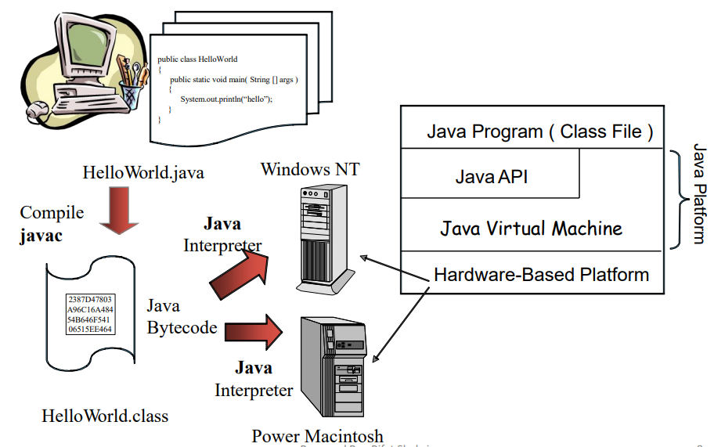
Java Platform

Slide 16
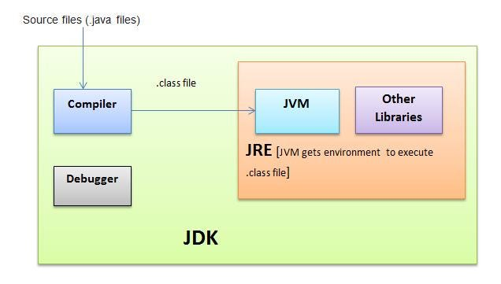

Slide 17
Bytecode
They are not machine language binary code
They are independent of any particular microprocessor or hardware platform
They are platform‐independent instructions
Another entity (interpreter) is required to convert the bytecodes into machine codes that the underlying microprocessor understands
This is the job of the JVM (Java Virtual Machine)

Slide 18
JVM (Java Virtual Machine)
It is a part of the JDK and the foundation of the Java platform
It can be installed separately or with JDK
A virtual machine (VM) is a software application that simulates a computer, but hides the underlying operating system and hardware from the programs that interact with the VM
It is the JVM that makes Java a portable language
The same bytecodes can be executed on any platform containing a compatible JVM
The JVM is invoked by the java command – java Welcome
It searches the class Welcome in the current directory and executes the main method of class Welcome
It issues an error if it cannot find the class Welcome or if class Welcome does not contain a method called main with proper signature

Slide 19
JIT Compiler
When a JIT compiler is part of the JVM, selected portions of bytecode are compiled into executable code in real time, on a piece-by-piece, demand basis.
An entire Java program is not compiled into executable code all at once, in this case.
Not all sequences of bytecode are compiled—only those that will benefit from compilation.
The remaining code is simply interpreted.

Slide 20
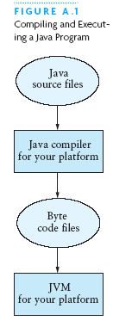
Commands for Reference:
Compiling and Executing a Java Program
Use javac <filename>.java to compile a java file using the command prompt
Use java <classname> to execute the class file that was generated by the javac command.

Slide 21
Primitive Data Types
Data type | Range of values
byte | -128 .. 127 (8 bits)
short | -32,768 .. 32,767 (16 bits)
int | -2,147,483,648 .. 2,147,483,647 (32 bits)
long | -9,223,372,036,854,775,808 .. ... (64 bits)
float | +/-10⁻³⁸ to +/-10⁺³⁸ and 0, about 6 digits precision
double | +/-10⁻³⁰⁸ to +/-10⁺³⁰⁸ and 0, about 15 digits precision
char | Unicode characters (generally 16 bits per char)
boolean | True or false

Slide 22
Operators
subscript [ ], call ( ), member access .
pre/post-increment ++ --, boolean complement !, bitwise complement ~, unary + -, type cast (type), object creation new
* / %
binary + - (+ also concatenates strings)
signed shift << >>, unsigned shift >>>
comparison < <= > >=, class test instanceof
equality comparison == !=
bitwise and &
bitwise or |
logical (sequential) and &&
logical (sequential) or ||
conditional cond ? true-expr : false-expr
assignment =, compound assignment += -= *= /= <<= >>= >>>= &= |=

Slide 23
Type Compatibility and Conversion
Widening conversion:
In operations on mixed-type operands, the numeric type of the smaller range is converted to the numeric type of the larger range
In an assignment, a numeric type of smaller range can be assigned to a numeric type of larger range
byte to short to int to long
int kind to float to double

Slide 24
Declaring and Setting Variables
int square;
square = n * n;
double cube = n * (double)square;
Can generally declare local variables where they are initialized
All variables get a safe initial value anyway (zero/null)

Slide 25

Referencing and Creating Objects
You can declare reference variables
They reference objects of specified types
Two reference variables can reference the same object
The new operator creates an instance of a class
A constructor executes when a new object is created
Example: String greeting = ″hello″;

Slide 26
Java Control Statements
A group of statements executed in order is written
{ stmt1; stmt2; ...; stmtN; }
The statements execute in the order 1, 2, ..., N
Control statements alter this sequential flow of execution

Slide 27
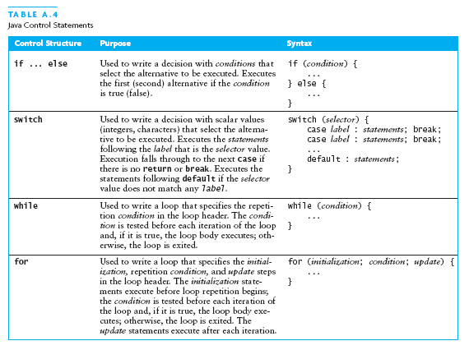
Java Control Statements (continued)

Slide 28
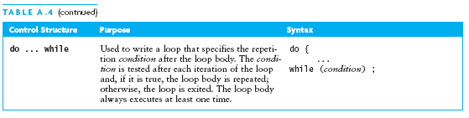
Java Control Statements (continued)

Slide 29
Methods
A Java method defines a group of statements as performing a particular operation
static indicates a static or class method
A method that is not static is an instance method
All method arguments are call-by-value
Primitive type: value is passed to the method
Method may modify local copy but will not affect caller’s value
Object reference: address of object is passed
Change to reference variable does not affect caller
But operations can affect the object, visible to caller

Slide 30
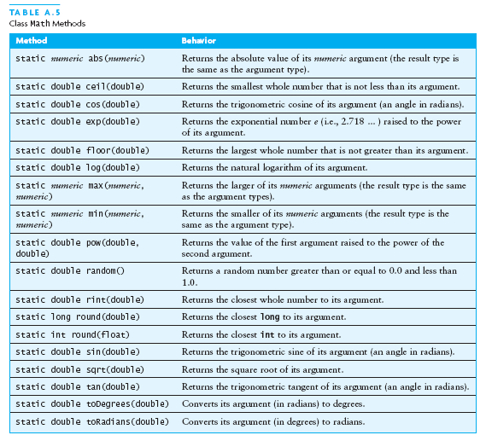
The Class Math

Slide 31
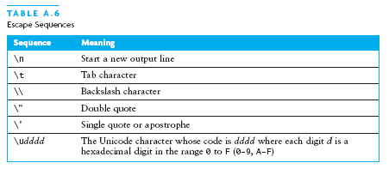
Escape Sequences
An escape sequence is a sequence of two characters beginning with the character \
A way to represents special characters/symbols

Slide 32
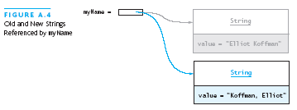
The String Class
The String class defines a data type that is used to store a sequence of characters
You cannot modify a String object
If you attempt to do so, Java will create a new object that contains the modified character sequence

Slide 33
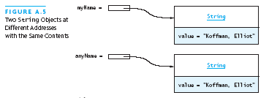

Comparing Objects
You can’t use the relational or equality operators to compare the values stored in strings (or other objects)
(You will compare the pointers, not the objects!)

Slide 34
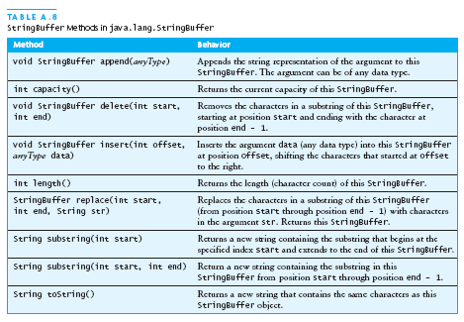
The StringBuffer Class
Stores character sequences
Unlike a String object, you can change the contents of a StringBuffer object

Slide 35
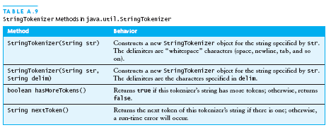
StringTokenizer Class
We often need to process individual pieces, or tokens, of a String

Slide 36
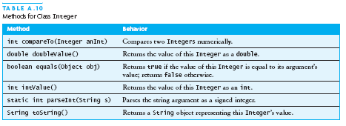
Wrapper Classes for Primitive Types
Sometimes we need to process primitive-type data as objects
Java provides a set of classes called wrapper classes whose objects contain primitive-type values: Float, Double, Integer, Boolean, Character, etc.

Slide 37
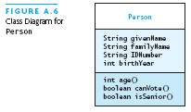
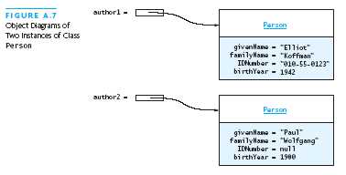
Defining Your Own Classes
Unified Modeling Language (UML) is a standard diagram notation for describing a class
Field signatures: type and name
Method signatures: name, argument types, result type
Field values
Class name
Class name

Slide 38
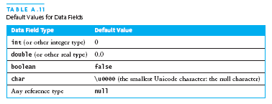
Defining Your Own Classes (continued)
The modifier private limits access to just this class
Only class members with public visibility can be accessed outside of the class* (* but see protected)
Constructors initialize the data fields of an instance

Slide 39
The Person Class
// we have omitted javadoc to save space
public class Person {
private String givenName;
private String familyName;
private String IDNumber;
private int birthYear;
private static final int VOTE_AGE = 18;
private static final int SENIOR_AGE = 65;
...

Slide 40
The Person Class (2)
// constructors: fill in new objects
public Person(String first, String family,
String ID, int birth) {
this.givenName = first;
this.familyName = family;
this.IDNumber = ID;
this.birthYear = birth;
}
public Person (String ID) {
this.IDNumber = ID;
}

Slide 41
The Person Class (3)
// modifier and accessor for givenName
public void setGivenName (String given) {
this.givenName = given;
}
public String getGivenName () {
return this.givenName;
}

Slide 42
The Person Class (4)
// more interesting methods ...
public int age (int inYear) {
return inYear – birthYear;
}
public boolean canVote (int inYear) {
int theAge = age(inYear);
return theAge >= VOTE_AGE;
}

Slide 43
The Person Class (5)
// “printing” a Person
public String toString () {
return “Given name: “ + givenName + “\n”
+ “Family name: “ + familyName + “\n”
+ “ID number: “ + IDNumber + “\n”
+ “Year of birth: “ + birthYear + “\n”;
}

Slide 44
The Person Class (6)
// same Person?
public boolean equals (Person per) {
return (per == null) ? false :
this.IDNumber.equals(per.IDNumber);
}

Slide 45
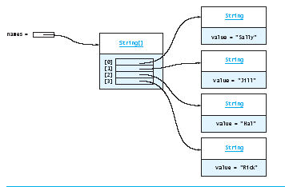
Arrays
In Java, an array is also an object
The elements are indexes and are referenced using the form arrayvar[subscript]

Slide 46
Array Example
float grades[] = new float[numStudents];
... grades[student] = something; ...
float total = 0.0;
for (int i = 0; i < grades.length; ++i) {
total += grades[i];
}
System.out.printf(“Average = %6.2f%n”,
total / numStudents);

Slide 47
Array Example Variations
// possibly more efficient
for (int i = grades.length; --i >= 0; ) {
total += grades[i];
}
// uses Java 5.0 “for each” looping
for (float grade : grades) {
total += grade;
}

Slide 48
Input/Output using Class JOptionPane
Java 1.2 and higher provide class JOptionPane, which facilitates display
Dialog windows for input
Message windows for output

Slide 49
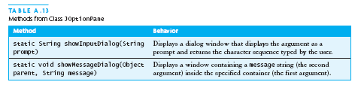

Input/Output using Class JOptionPane (continued)

Slide 50
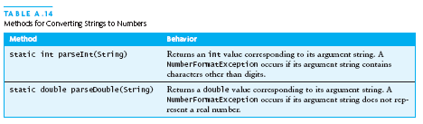
Converting Numeric Strings to Numbers
A dialog window always returns a reference to a String
Therefore, a conversion is required, using static methods of class String:

Slide 51
Input/Output using Streams
An InputStream is a sequence of characters representing program input data
An OutputStream is a sequence of characters representing program output
The console keyboard stream is System.in
The console window is associated with System.out

Slide 52
Opening and Using Files: Reading Input
import java.io.*;
public static void main (String[] args) {
// open an input stream (**exceptions!)
BufferedReader rdr =
new BufferedReader(
new FileReader(args[0]));
// read a line of input
String line = rdr.readLine();
// see if at end of file
if (line == null) { ... }

Slide 53
Opening and Using Files: Reading Input (2)
// using input with StringTokenizer
StringTokenizer sTok =
new StringTokenizer (line);
while (sTok.hasMoreElements()) {
String token = sTok.nextToken();
...;
}
// when done, always close a stream/reader
rdr.close();

Slide 54
Alternate Ways to Split a String
Use the split method of String:
String[] = s.split(“\\s”);
// see class Pattern in java.util.regex
Use a StreamTokenizer (in java.io)

Slide 55
Opening and Using Files: Writing Output
// open a print stream (**exceptions!)
PrintStream ps = new PrintStream(args[0]);
// ways to write output
ps.print(“Hello”); // a string
ps.print(i+3); // an integer
ps.println(“ and goodbye.”); // with NL
ps.printf(“%2d %12d%n”, i, 1<<i); // like C
ps.format(“%2d %12d%n”, i, 1<<i); // same
// closing output streams is very important!
ps.close();

Slide 56
Summary of the Review
A Java program is a collection of classes
The JVM approach enables a Java program written on one machine to execute on any other machine that has a JVM
Java defines a set of primitive data types that are used to represent numbers, characters, and boolean data
The control structures of Java are similar to those found in other languages
The Java String and StringBuffer classes are used to reference objects that store character strings

Slide 57
Chapter Review (continued)
Be sure to use methods such as equals and compareTo to compare the contents of String objects
You can declare your own Java classes and create objects of these classes using the new operator
A class has data fields and instance methods
Array variables can reference array objects
Class JOptionPane can be used to display dialog windows for data entry and message windows for output
The stream classes in package java.io read strings from the console and display strings to the console, and also support file I/O

